Slide 1
HIS 103: Lecture 8
Lahore (Pakistan) Resolution, 1940
February 28, 2022

Slide 2
Lahore (Pakistan) Resolution, 1940
Background
The Two Nation Theory
Highlights of the Resolution
Points of Ambiguity
Reactions of the Hindu Community/ Congress
Significance of the Lahore Resolution

Slide 3
Lahore (Pakistan) Resolution, 1940
Background:
In March 1940, M. A. Jinnah called for a General Session of the All India Muslim League in Lahore. Why?
to discuss the situation that had arisen due to the outbreak of the WW-II and the Government of India joining the War without taking the opinion of the Indian leaders;
to analyze the reasons that led to the defeat of the Muslim League in the general election of 1937 in the Muslim majority provinces.
On March 23, 1940 the famous Lahore Resolution was moved, and unanimously passed at the 27th annual meeting of the All India Muslim League on March 24, 1940 at Lahore.
Although Sikandar Hayat Khan, the Chief Minister of the Punjab, drafted the original Lahore Resolution, Sher-E-Bangla A K Fazlul-Huq, the then Chief Minister of Bengal proposed the resolution.

Slide 4
Lahore (Pakistan) Resolution, 1940
The Two Nation Theory:
Simply means the cultural, religious, political and socio-economic dissimilarities between the two major communities of the Indian sub-continent, namely the Hindus and the Muslims.
Sir Syed Ahmed Khan is the ‘architect’ of the idea. He first used the term “two nation theory” due to Hindi-Urdu controversy in Banaras in 1867.
Allama Iqbal coined the idea of separate homeland for the Muslims on the basis of the two nation theory in December 1930 at the Allahabad Session of the All India Muslim League.
Instrumental political leaders in materializing the two nation theory: Sir Syed Ahmed Khan, Allama Iqbal, Quaid-E-Azam M. A. Jinnah and Chowdhury Rahamat Ali.

Slide 5
Lahore Resolution, 1940
AIML Presidental Speech of M. A. Jinnah at Lahore, March 1940:
‘It is extremely difficult to appreciate why our Hindu friends fail to understand the real nature of Islam and Hinduism. They are not religions in the strict sense of the word, but are, in fact, different and distinct social orders, and it is a dream that the Hindus and Muslims can ever evolve a common nationality, and this misconception of one Indian nation has troubles and will lead India to destruction if we fail to revise our notions in time.
The Hindus and Muslims belong to two different religious philosophies, social customs, and litterateurs. They neither intermarry nor interdine together and, indeed, they belong to two different civilizations which are based mainly on conflicting ideas and conceptions. Their aspect on life and of life are different. It is quite clear that Hindus and Mussalmans derive their inspiration from different sources of history. They have different epics, different heroes, and different episodes. Very often the hero of one is a foe of the other and, likewise, their victories and defeats overlap.
To yoke together two such nations under a single state, one as a numerical minority and the other as a majority, must lead to growing discontent and final destruction of any fabric that may be so built for the government of such a state.’

Slide 6
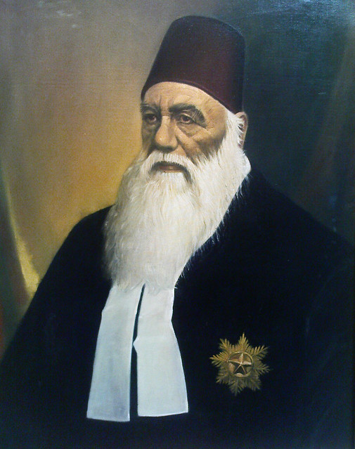
Sir Syed Ahmed Khan

Slide 7
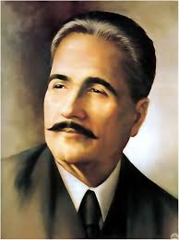
Allama Iqbal

Slide 8
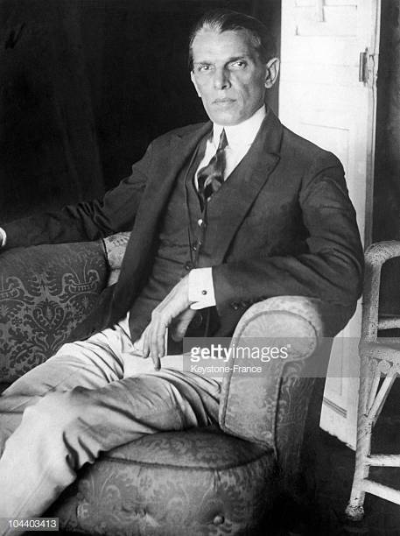
Muhammad Ali Jinnah

Slide 9
Lahore (Pakistan) Resolution, 1940
Full Text of the Lahore Resolution:
“Resolved that it is the considered view of this Session of the All India Muslim League that no constitutional plan would be workable in this country or acceptable to Muslims unless it is designed on the following basic principle, namely that geographically contiguous units are demarcated into regions which should be so constituted, with such territorial readjustments as may be necessary, that the areas in which the Muslims are numerically in a majority as in the North-Western and Eastern Zones of India, should be grouped to constitute “Independent States” in which the constituent units shall be autonomous and sovereign.
That adequate, effective and mandatory safeguards should be specifically provided in the constitution for minorities in these units and in these regions for the protection of their religious, cultural, economic, political, administrative and other rights and interests in consultation with them; and in other parts of India where the Mussalmans are in a minority, adequate, effective and mandatory safeguards shall be specially provided in the constitution for them and other minorities for the protection of their religious, cultural, economic, political, administrative and other rights and interests in consultation with them.”

Slide 10
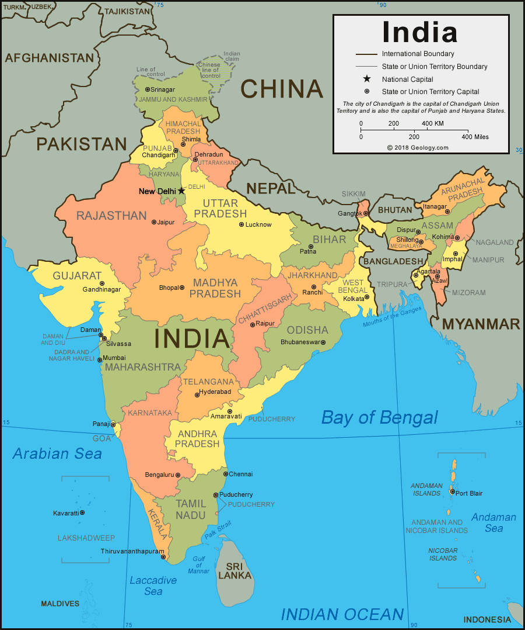
Map of South Asia

Slide 11
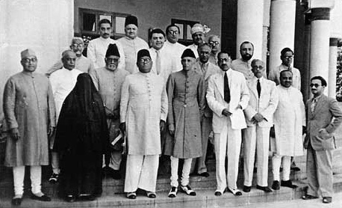
Lahore (Pakistan) Resolution, 1940
Delegates at the Lahore Resolution, 1940

Slide 12
Lahore (Pakistan) Resolution, 1940
Highlights of the Lahore Resolution:
Geographically contiguous units or regions of India should be made separate states;
The Muslim majority regions, i.e., the North-western and Eastern zones of India, should form a Muslim State, i.e. Pakistan;
The constituent units of Pakistan should be fully autonomous;
Protection of all rights and interests of the minorities both in Pakistan and Hindustan (India) should be guaranteed in consultation with the representatives of minorities.
This should be regarded as the basic principles for any constitutional plan for this sub-continent.

Slide 13
Lahore (Pakistan) Resolution, 1940
Points of Ambiguity:
Reference to ‘Independent States in which constituent units shall be autonomous and sovereign’ contains an element of self-contradiction.
Independent States: North-Western (West Pakistan) and Eastern (East Pakistan).
The constituent units of “Independent States” cannot be “autonomous and sovereign” at the same time.
If the units are to be “autonomous,” they cannot be “sovereign” and if they are “sovereign,” they cannot be autonomous.”
The 1940 resolution nowhere mentioned “Pakistan” and in asking for 'independent states' the spokesmen of the League were far from clear what was intended.
However, some Hindu newspapers coined the term ‘Pakistan Revolution’, thus, indirectly helping the Muslim leadership to speed up their demands for a separate state for the Muslims.
By emphasizing the idea of Pakistan the Hindu press succeeded in converting a wordy and clouded lawyer's formula into a clarion call.

Slide 14
Lahore (Pakistan) Resolution, 1940
However, because of increasing confusion with the contents of the Lahore Resolution, Jinnah revised his earlier interpretation of the Resolution in 1941 at the Madras Session of the AIML:
‘Every one should clearly understand that we are striving for one independent and sovereign Muslim state.’
He also used the word “an independent homeland” or “an independent Muslim state.”
This contradiction in the Lahore Resolution was removed by a resolution passed by the Muslim League Legislators’ Convention on April 9, 1946.

Slide 15
Lahore (Pakistan) Resolution, 1940
Reactions of the Hindu Community (and the Congress):
Quick, bitter and hateful reaction from the Hindu Community: it was “anti-national,” “vivisection of motherland.”
They denounced it ‘as imperialist inspired to obstruct India’s march to freedom.’
Gandhi bitterly criticized the resolution and called it “a sin” and ‘severe moral illness of Muslim League.’
Raj Gopal Achariya said that ‘the step of Mr Jinnah is like that two brothers have a fight on the same cow, and they cut it and divide it.’

Slide 16
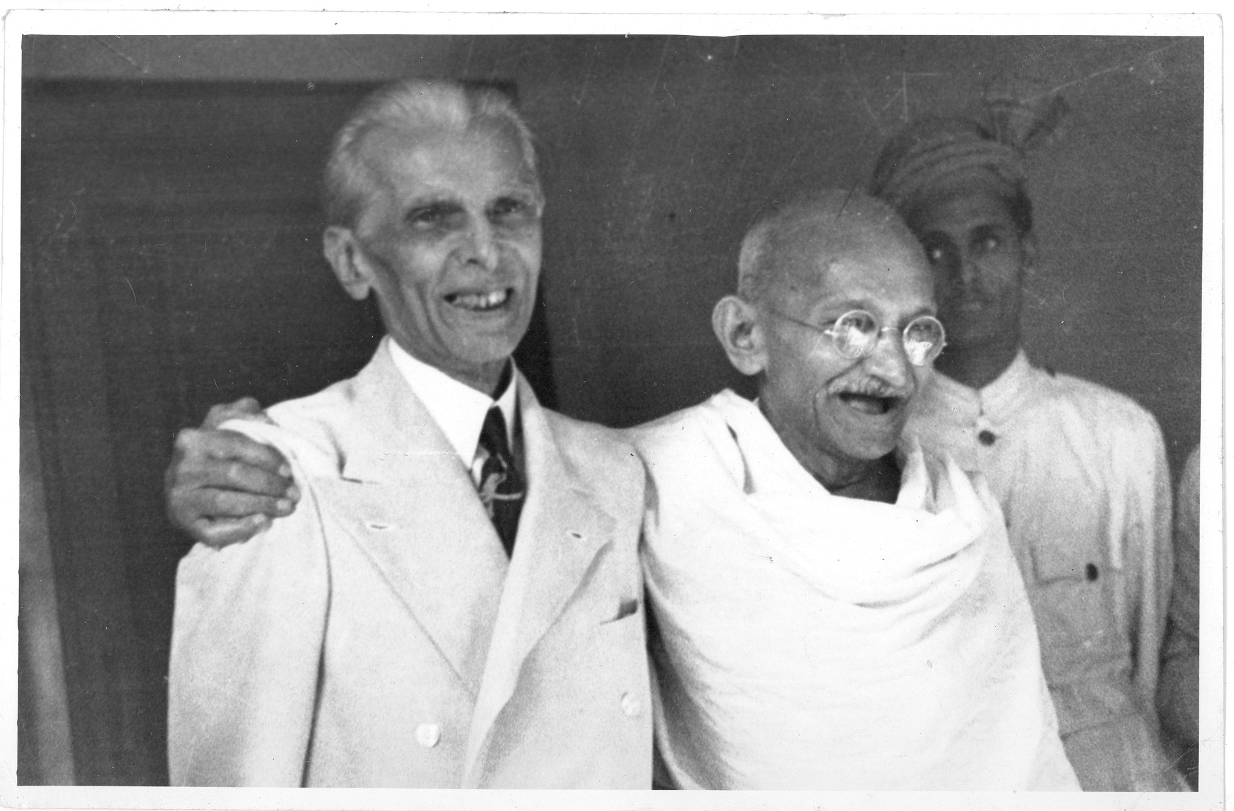
Jinnah and Gandhi Together

Slide 17
Lahore (Pakistan) Resolution, 1940
Significance of the Lahore Resolution:
Setting the goals: It set the goal/target of the Indian Muslims to create their own country, PAKISTAN;
Unity of the Muslims: Having the ‘goal’ Muslims in India started uniting under the platform of Muslim League (enhancement of the prestige of Muslim League);
Stronger demand for a Islamic State (Muslim Nationalism)- from ‘separate electorate’ to ‘separate state’;
Rise of Muslim League as the sole Representative Muslim Party in India;
Impetus to freedom movement.

